Slide 1


Building Affinity: Terps to UMD
Rekindling the connection
IBM Public Service | © 2016 IBM Corporation

Slide 2
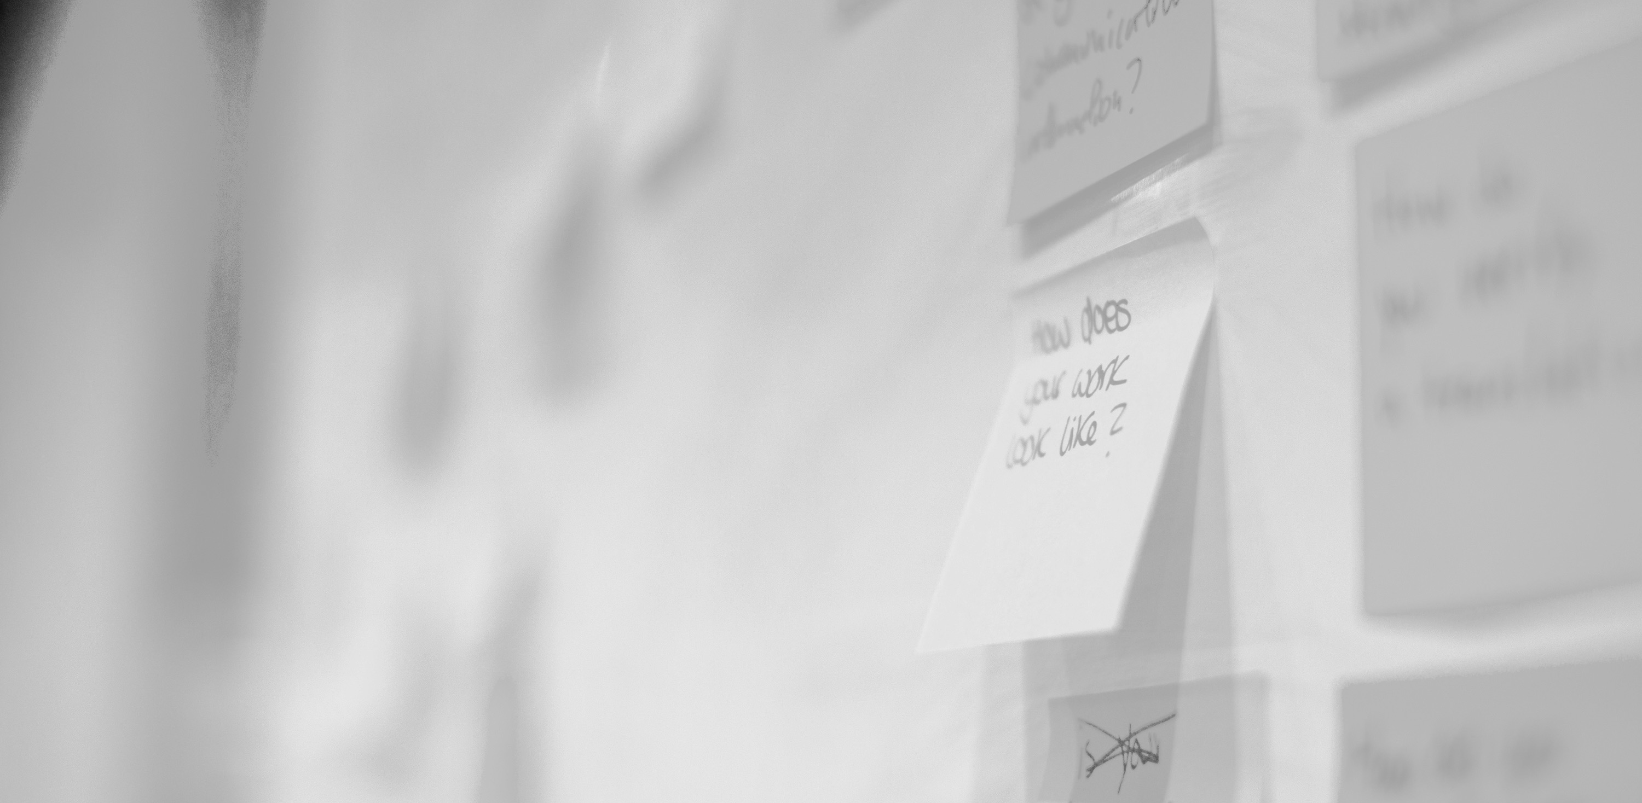
The Journey
What does it mean to be a Terp? What kind of connection to UMD does the average Terp have?
IBM Public Service | © 2016 IBM Corporation

Slide 3
Preview
Initial Concepts
Getting to Know Each Other
Digging into the Challenge
A Glimpse of the Possible
IBM Public Service | © 2016 IBM Corporation

Slide 4
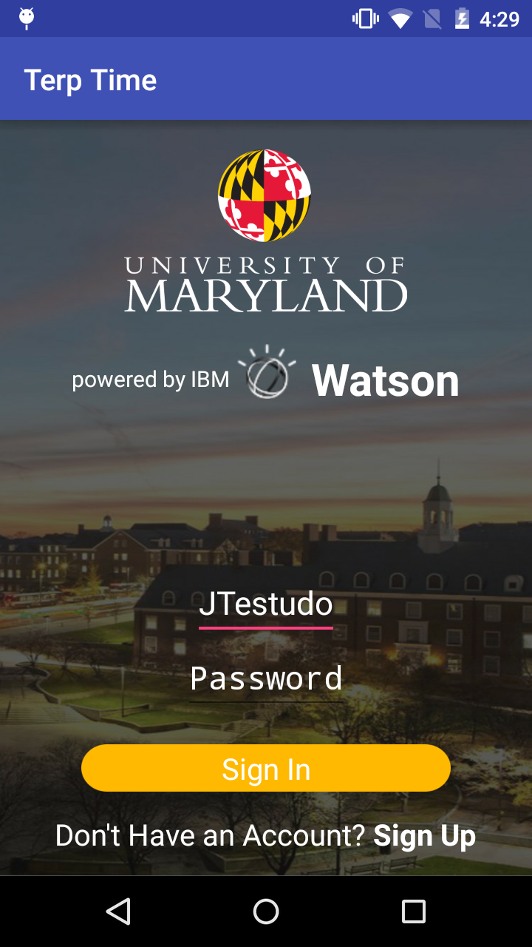
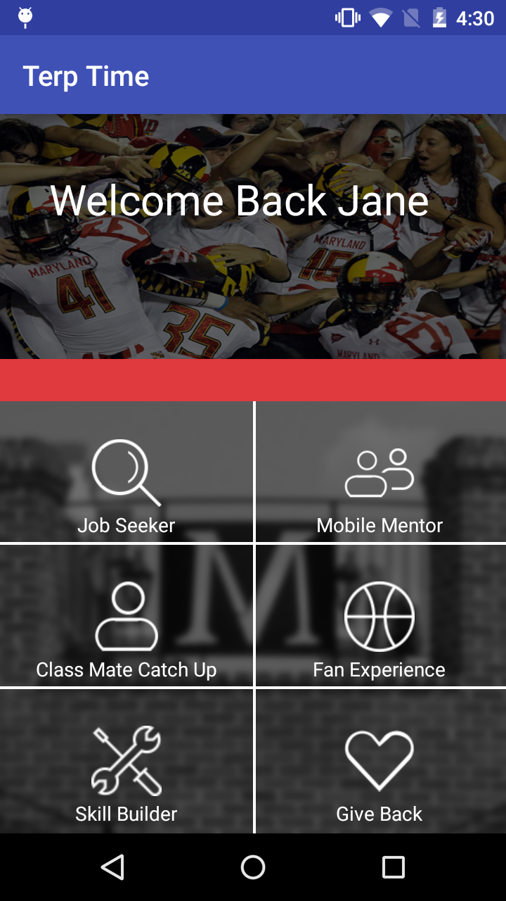
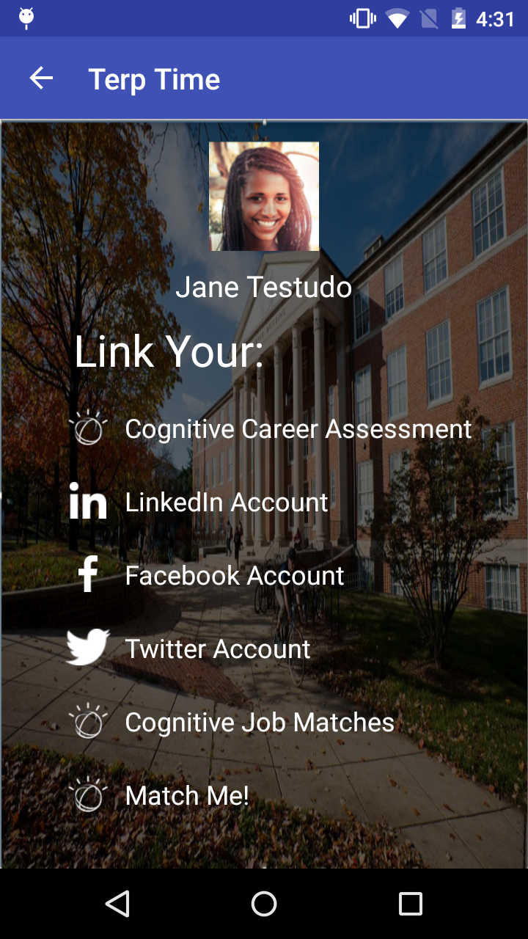











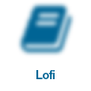






August
Concept
FIRST ITERATION
Innovation: How can we use cognitive to match UMD alumni and students mentees
Concept Level Design: The screens were based on UMD suggestions
Goal: Create a concept to spur discussion & ideation
Diversity in thought makes for strong solutions
IBM Public Service | © 2016 IBM Corporation

Slide 5

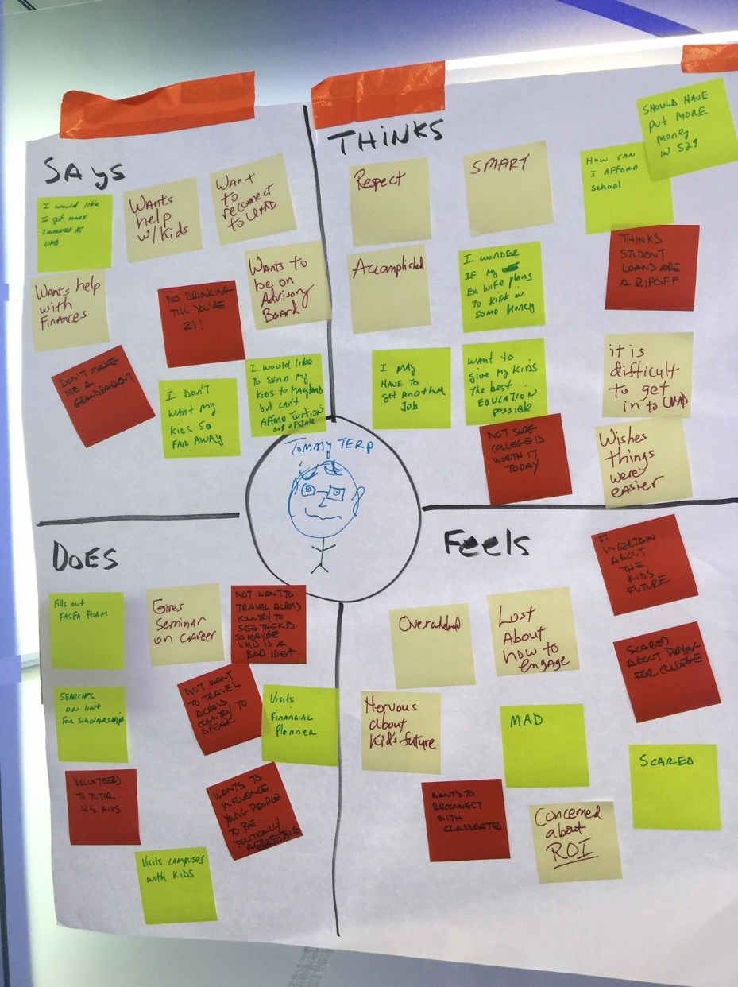
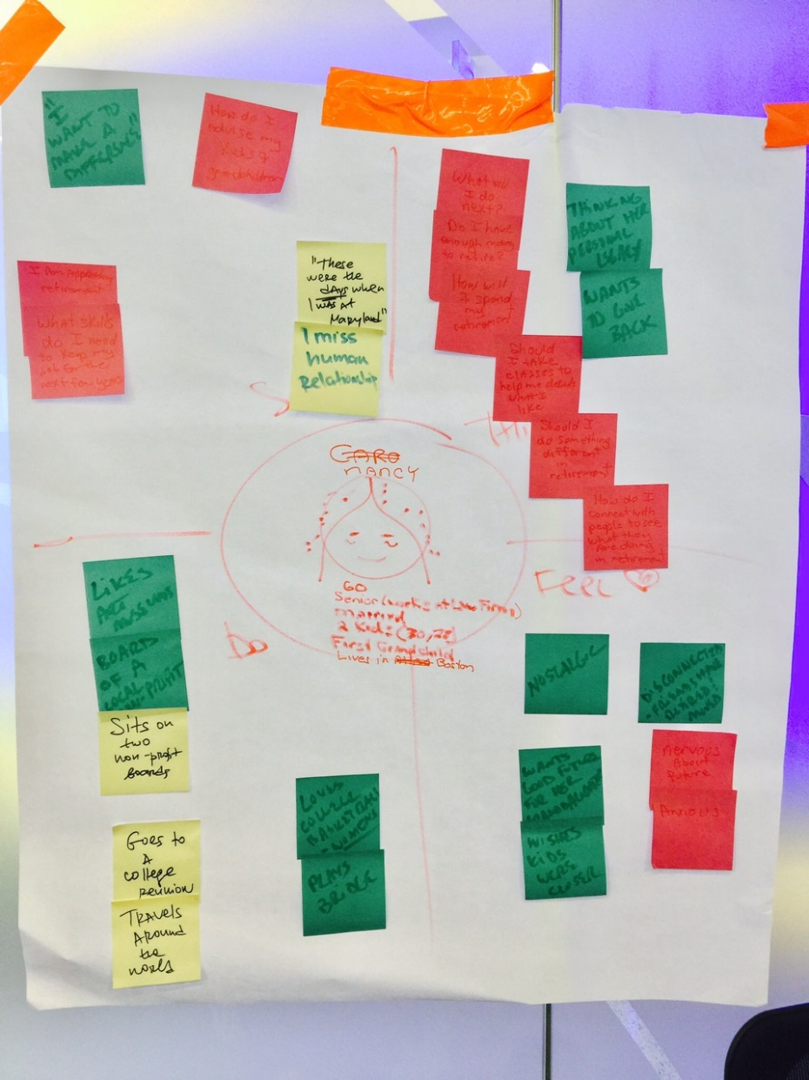
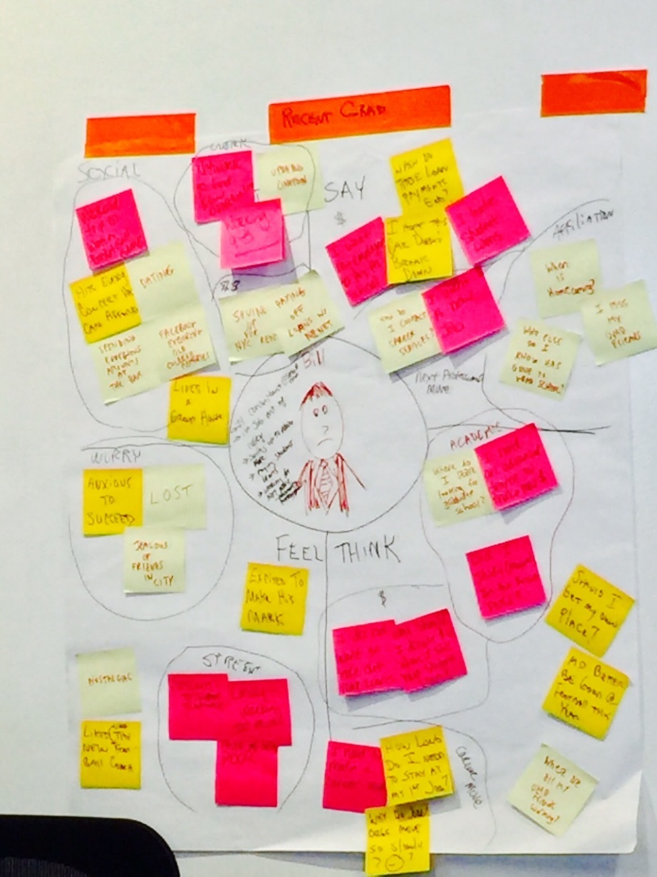
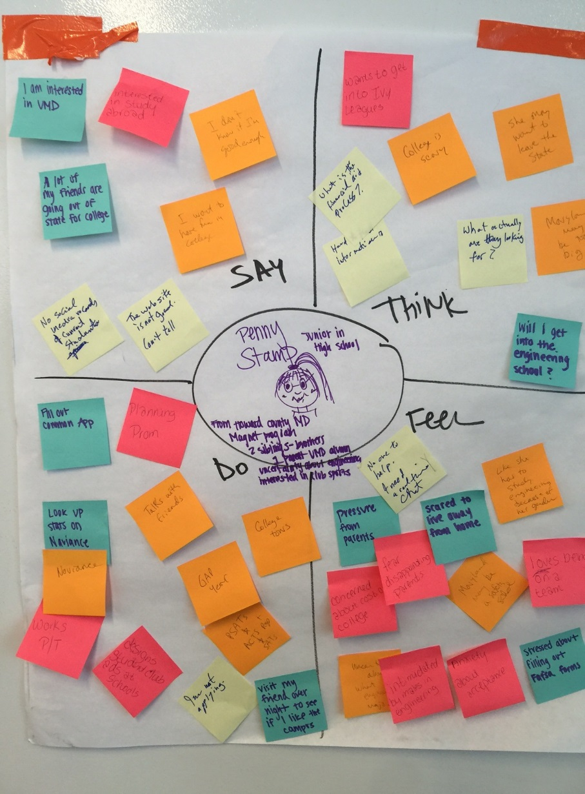
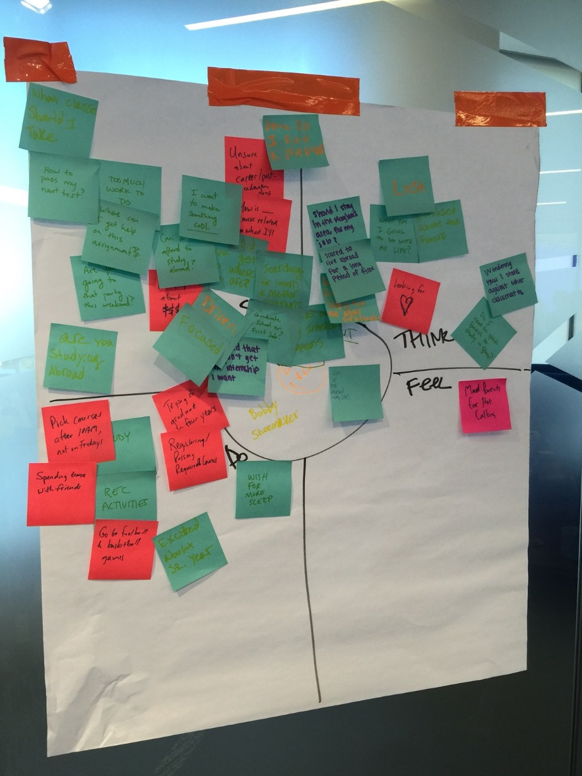
September
SECOND ITERATION
Watson & Persona Development
DOING: Fills out a FAFSA form, Visits financial planner, Spending time with friends, Plays bridge, Looks up statistics on Naviance, Updating Linkedin
SAYING: “I would like to get more involved at UMD”, “How do I find a mentor”, “I still want to make a difference”, “I’m interested in UMD”, “I miss my UMD friends”
THINKING: “How can I afford school”, “What I’m I going to do with my life”, “Thinks about her personal legacy”, “Maryland may be too big”, “I Need More money
FEELING: Overwhelmed,
Disconnect, Confused, Pressured,
Lost, and Lonely
Astor Place
Diversity in thought makes for strong solutions
IBM Public Service | © 2016 IBM Corporation

Slide 6
IBM Design Thinking
IBM Public Service | © 2016 IBM Corporation

Slide 7
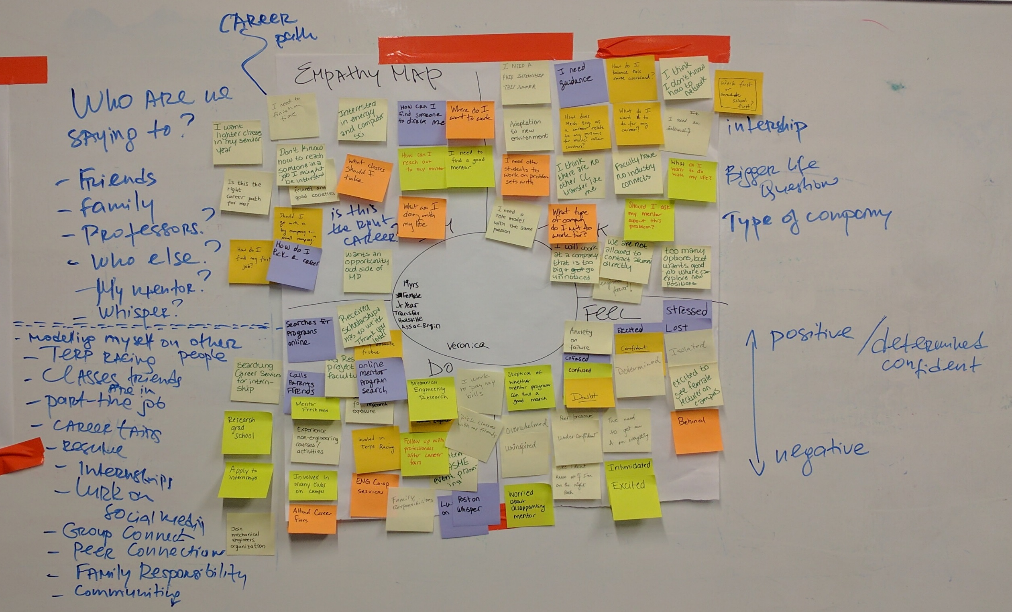
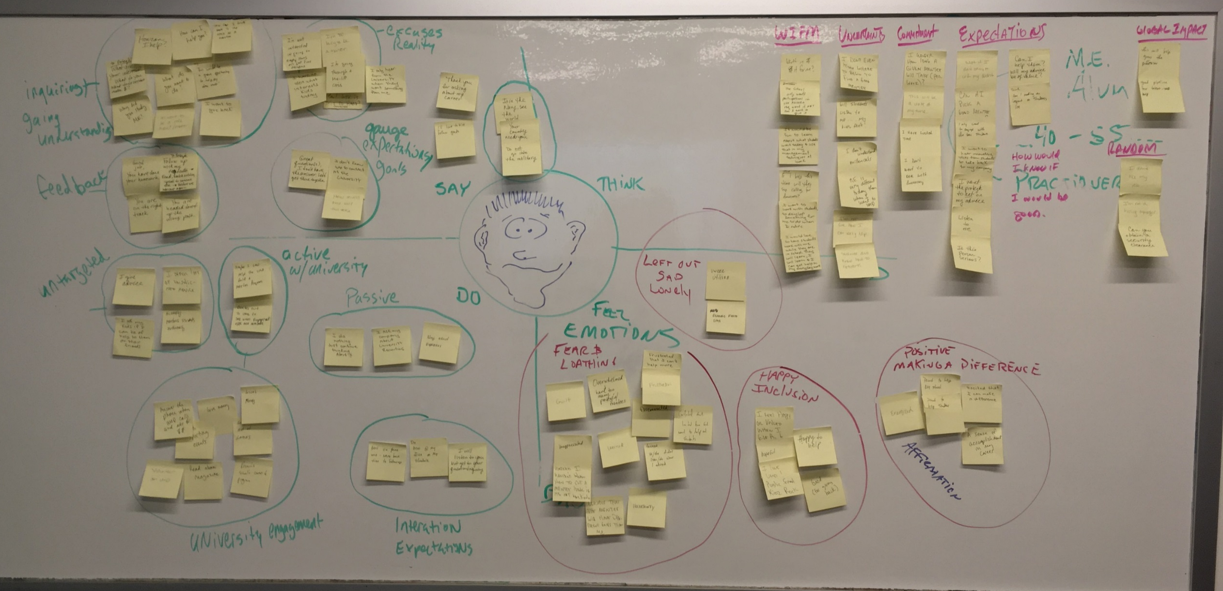
November
EMPATHY MAPS
DOING: Lurk on social media, Apply to internships, asks company about university recruiting, gives advice to others
SAYING: “What am I doing with my life”, “What Classes should I take”
THINKING: “I don’t know how to network”, “Faculty have no connections in industry”, “I want to work with students”, “What is in this for me”
FEELING: Stressed, Overwhelmed, Doubt,
Disconnect, Excitement
Diversity in thought makes for strong solutions
IBM Public Service | © 2016 IBM Corporation

Slide 8
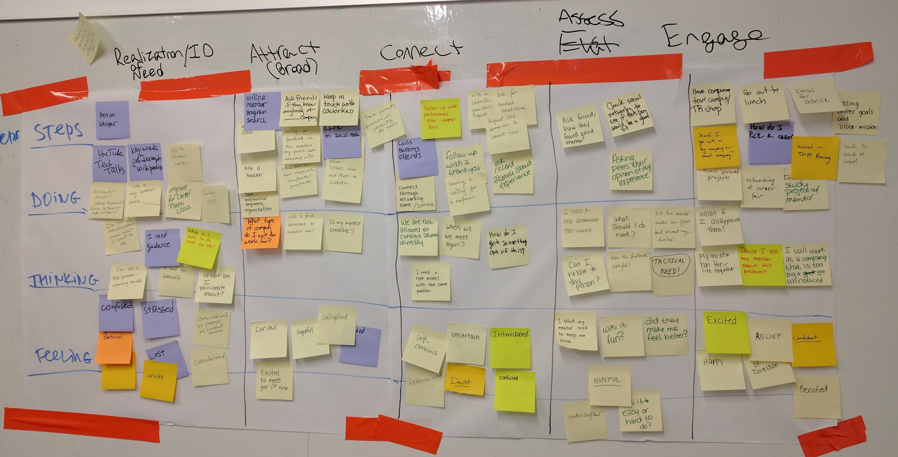
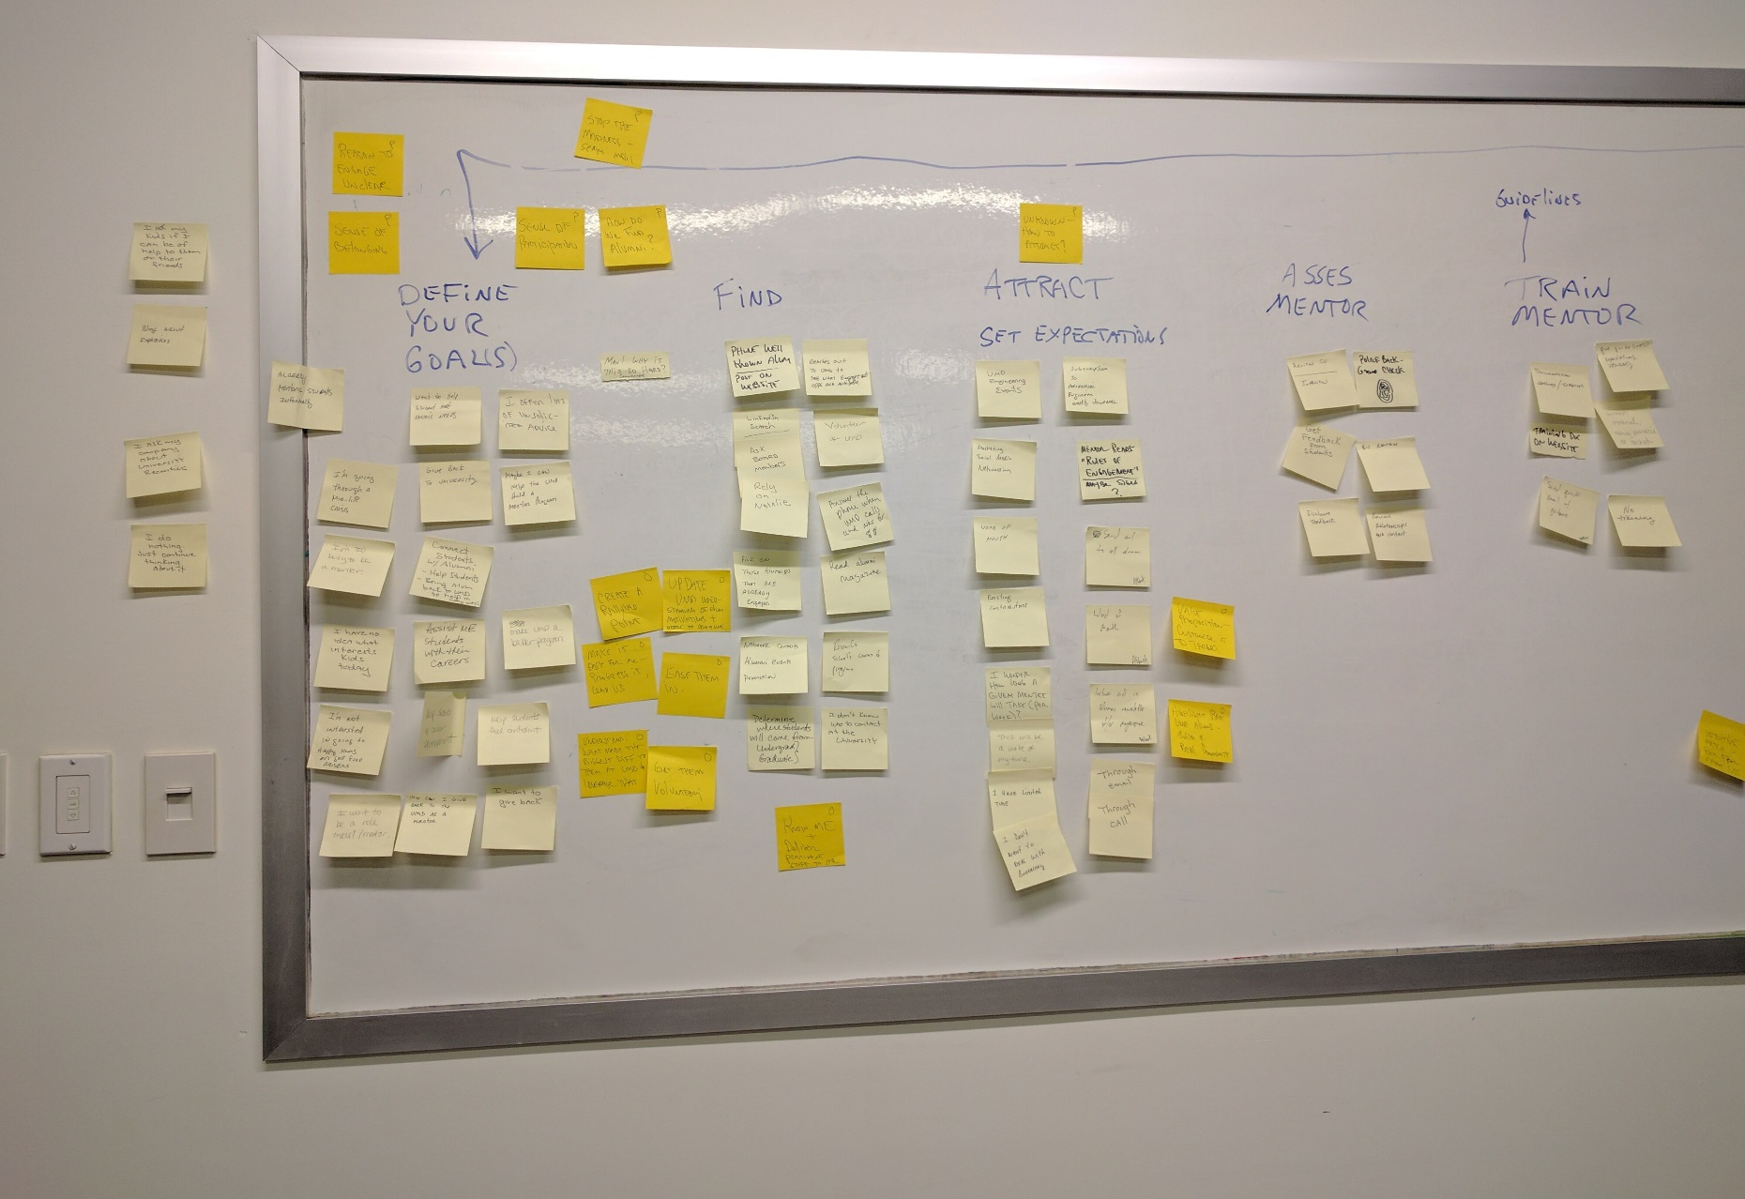
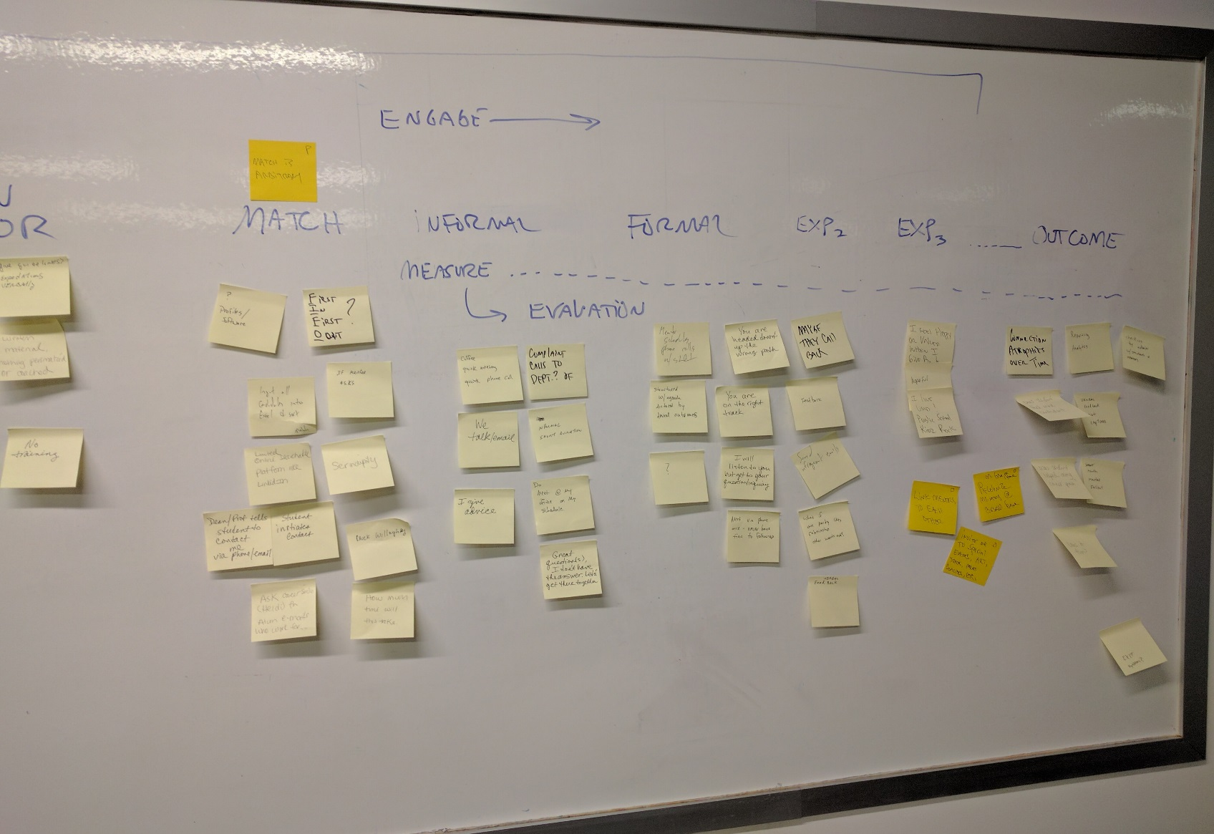
November
SCENARIO MAPPING
Mentor:
Define Goals
Find
Attract
Assess Mentor
Train Mentor
Match
Engage (Informal, Formal, Etc.)
Mentee:
Realization/ ID of Need
Attract (Broad)
Connect
Assess
Engage
Diversity in thought makes for strong solutions
IBM Public Service | © 2016 IBM Corporation

Slide 9
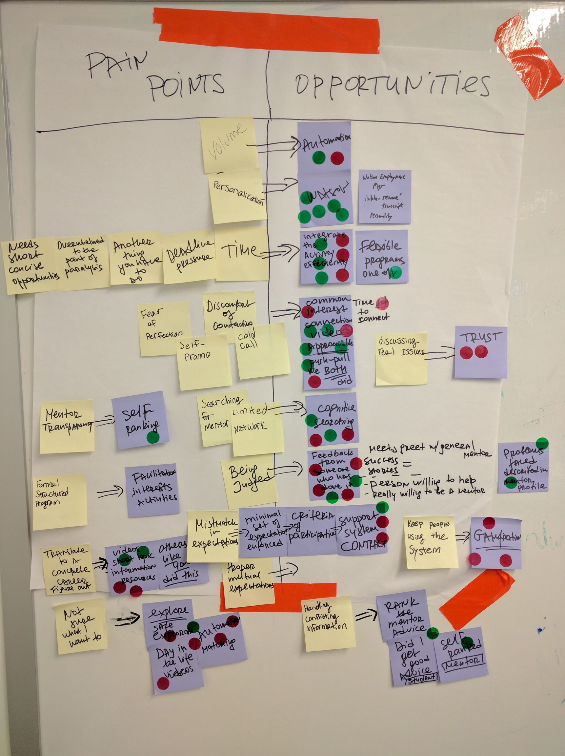

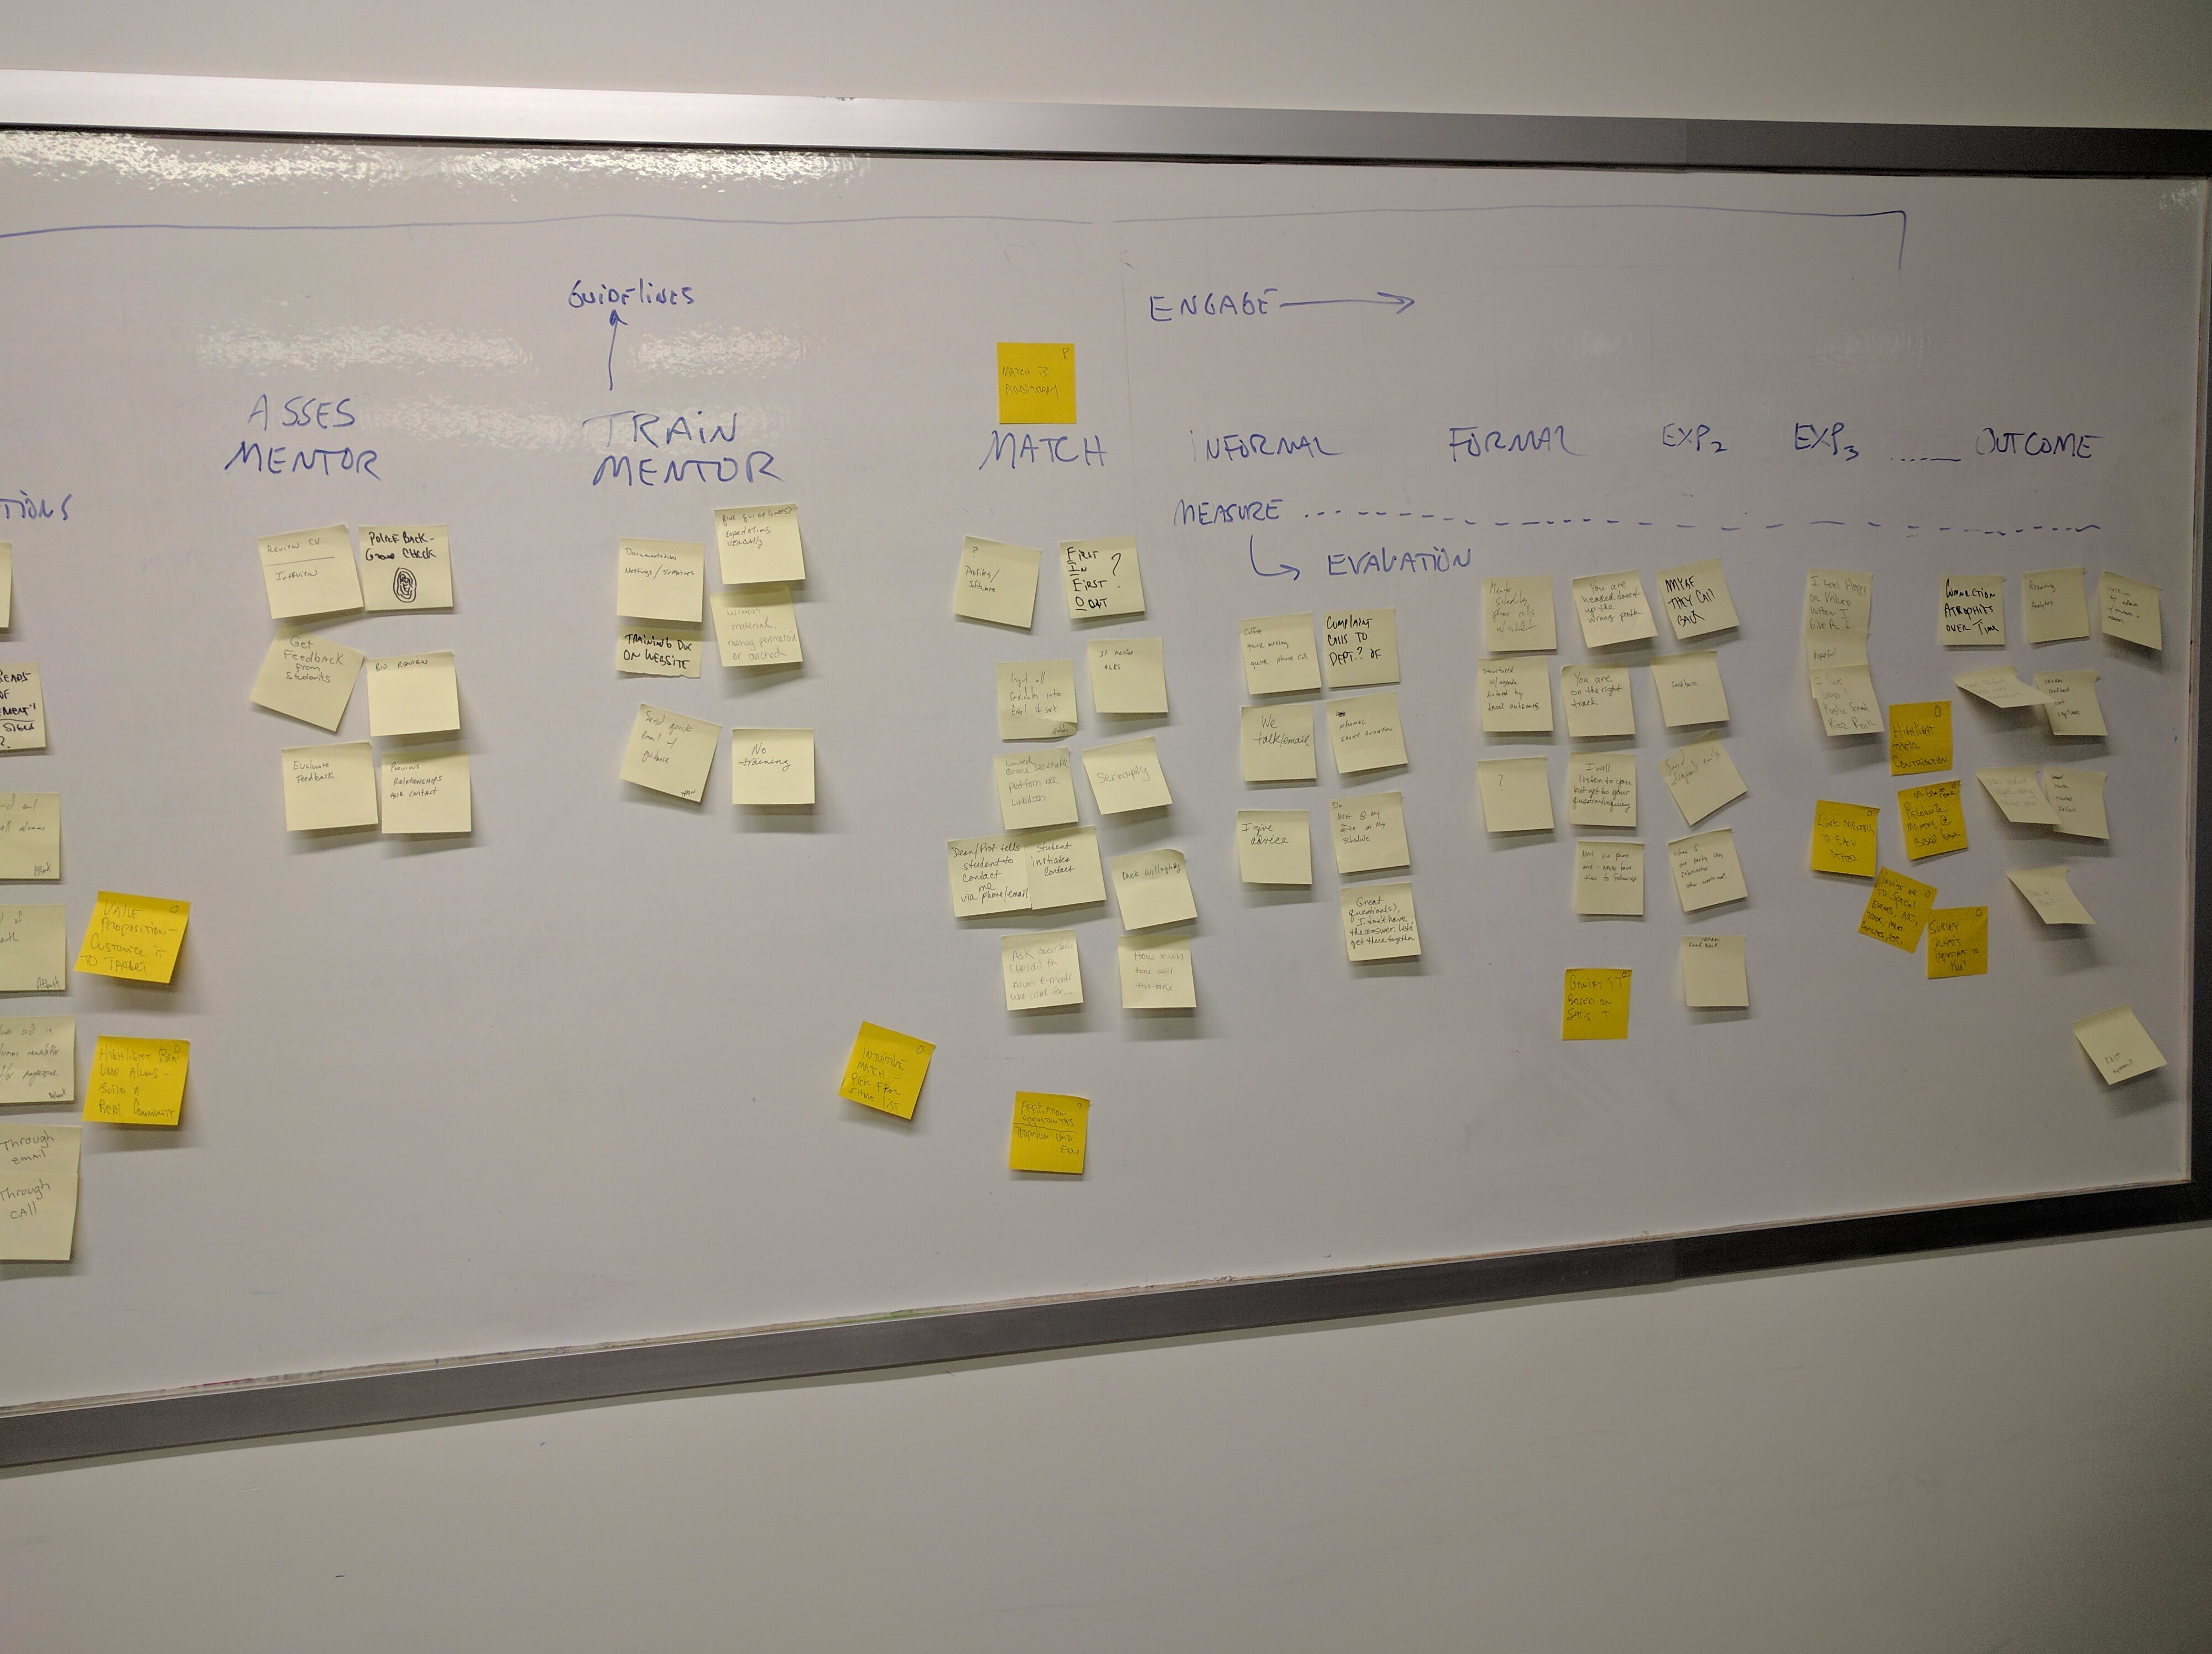
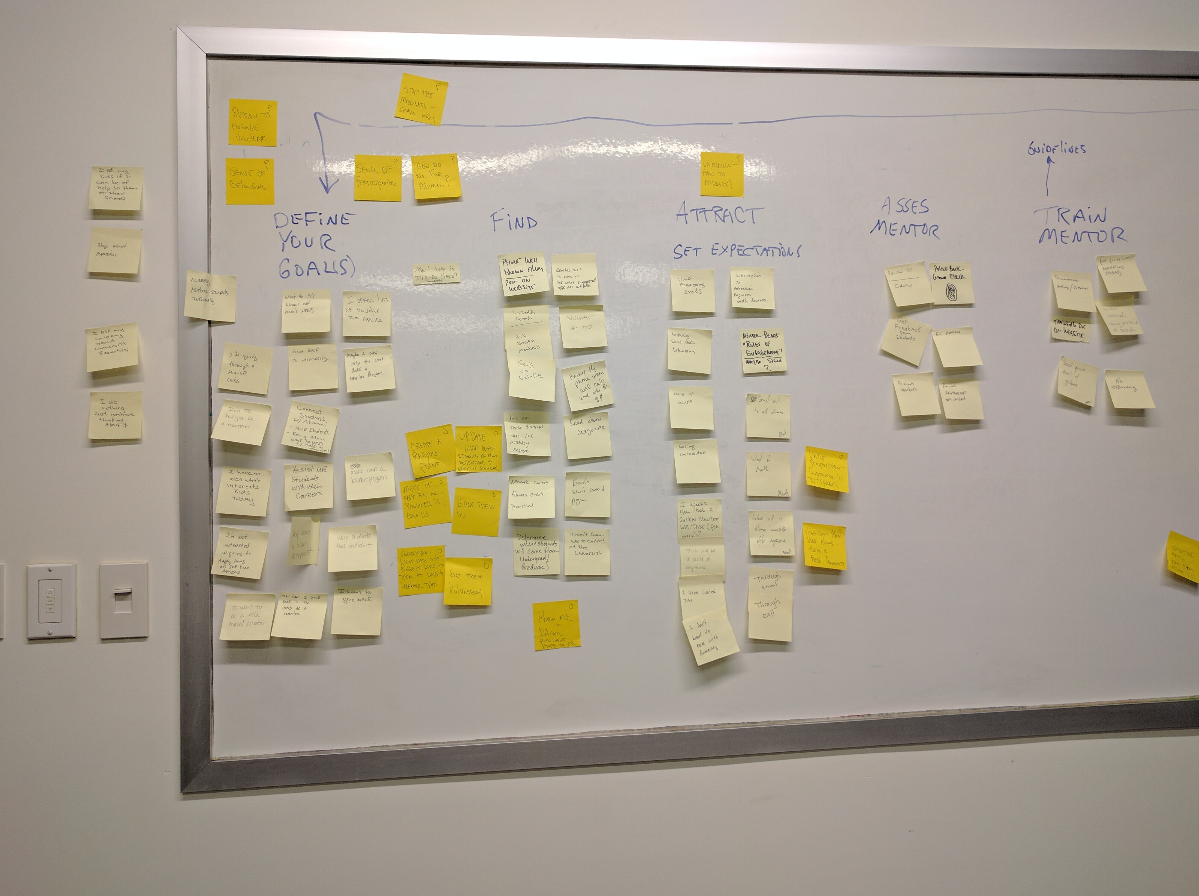
November
PAIN POINTS
Mentors: The Amount of Spam mail, Missing a sense of participation, Reason to engage unclear, Missing a sense of belonging, Match is Arbitrary, mentee selection, What am I getting in return, How is this going to help me build my network, Scheduling - aligning with the mentee
Mentees: Volume of potential connections, Lack of personalization, Needing to cold call to setup, Being Judged, Mentor Transparency, Mismatch of expectations, Lack of a formal structured program, Handling conflicting information, Lack of meaningful discussion, Crunch for time
IBM Public Service | © 2016 IBM Corporation

Slide 10
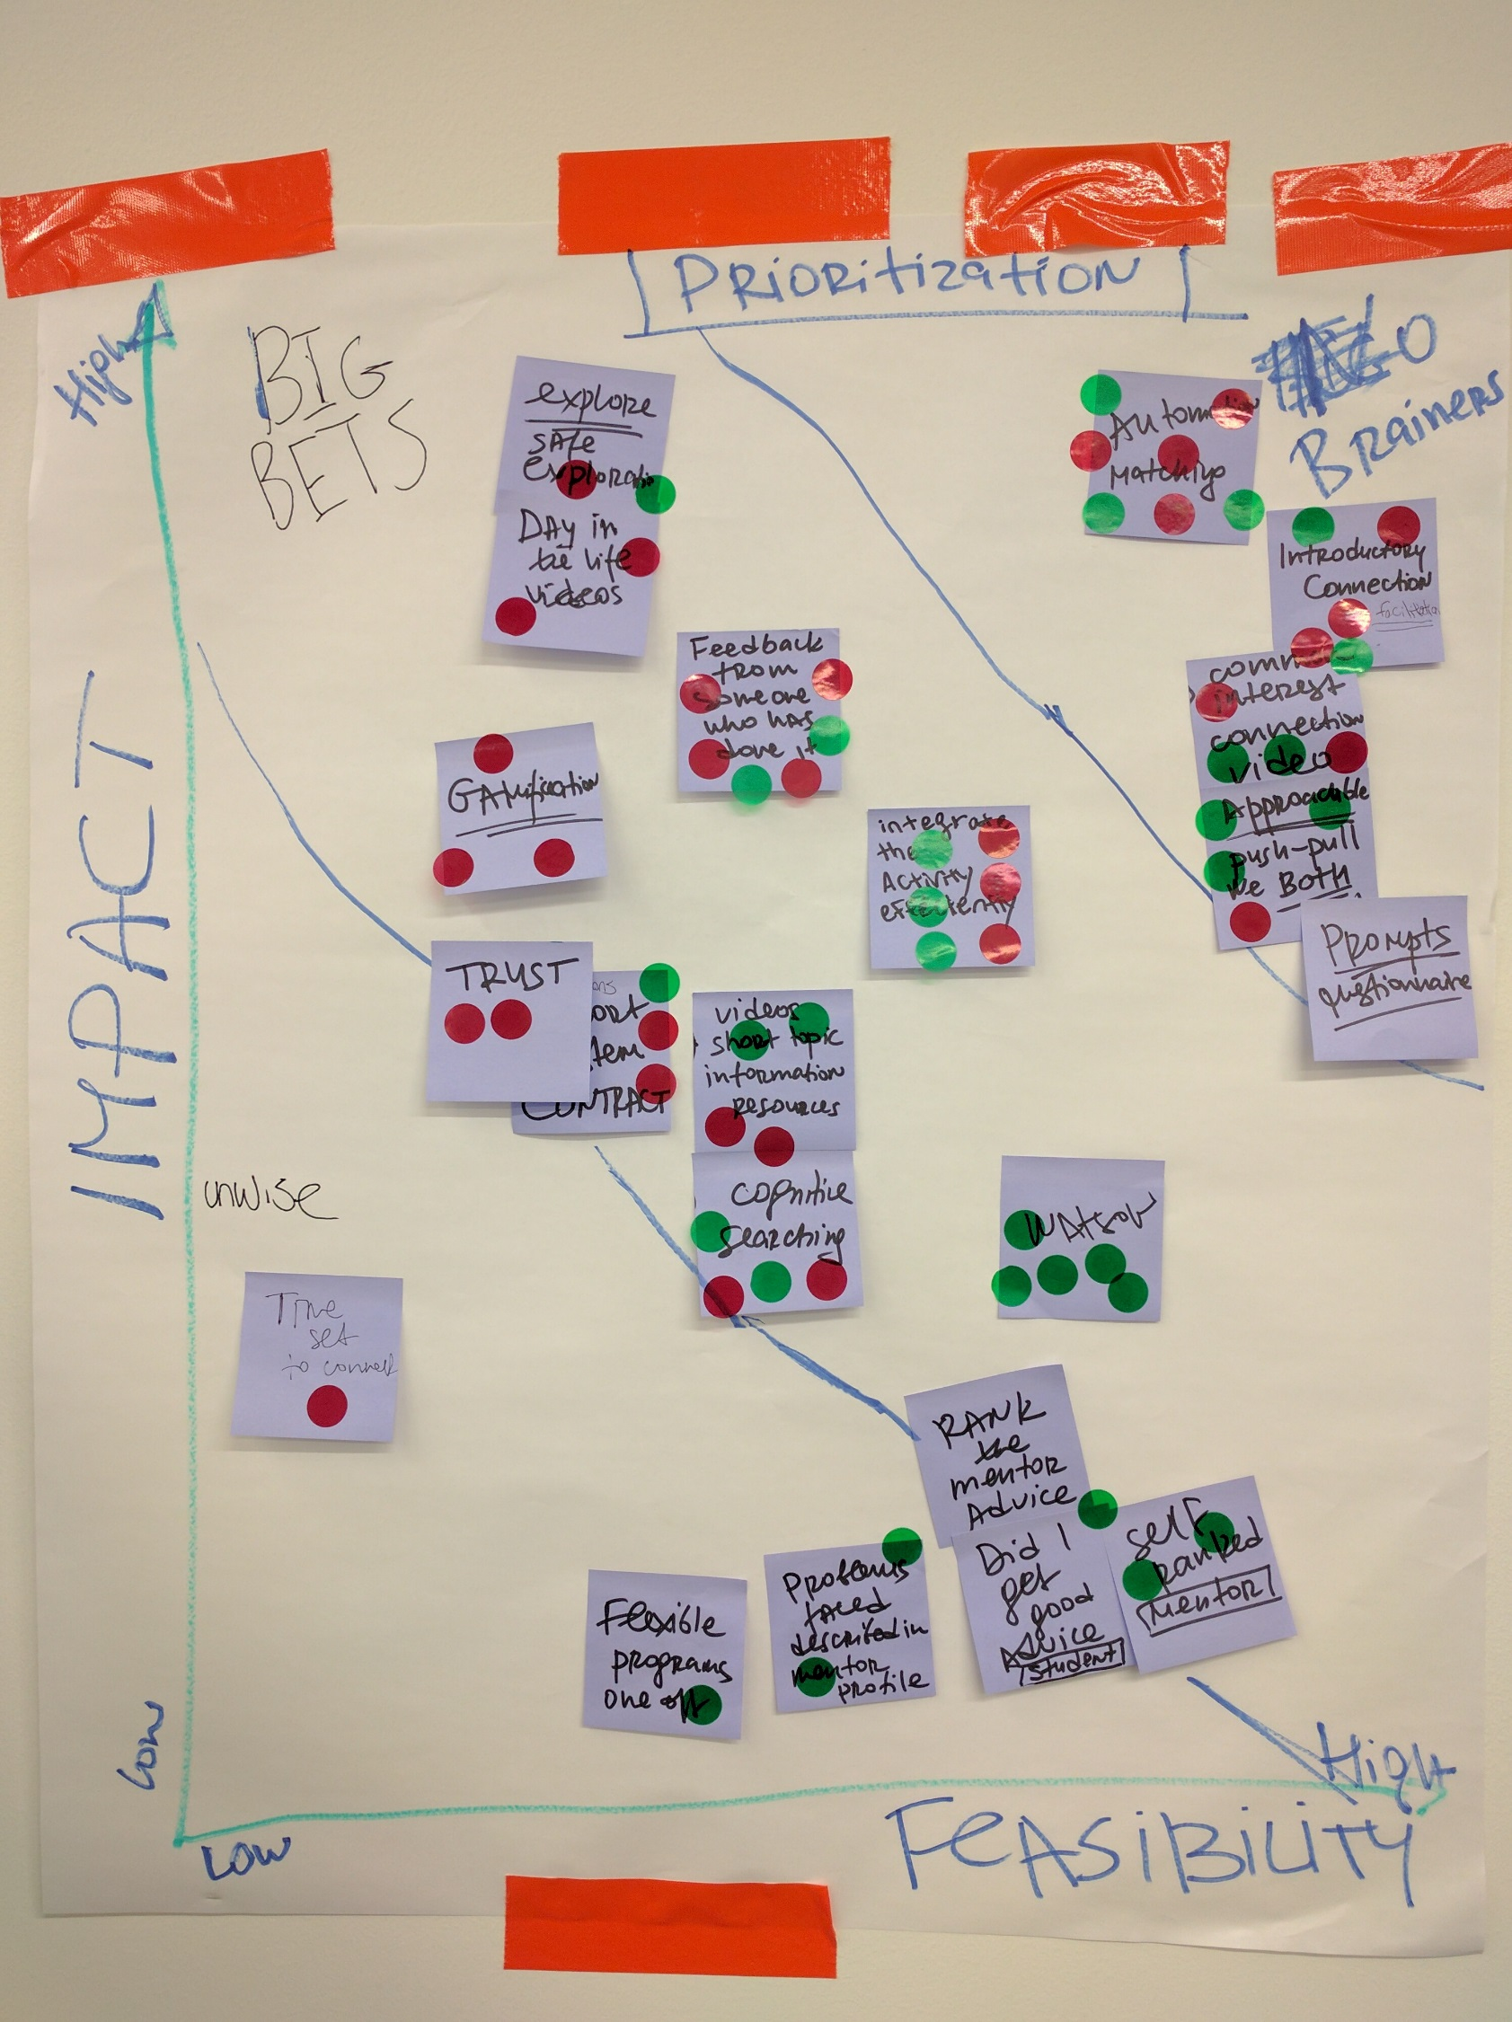
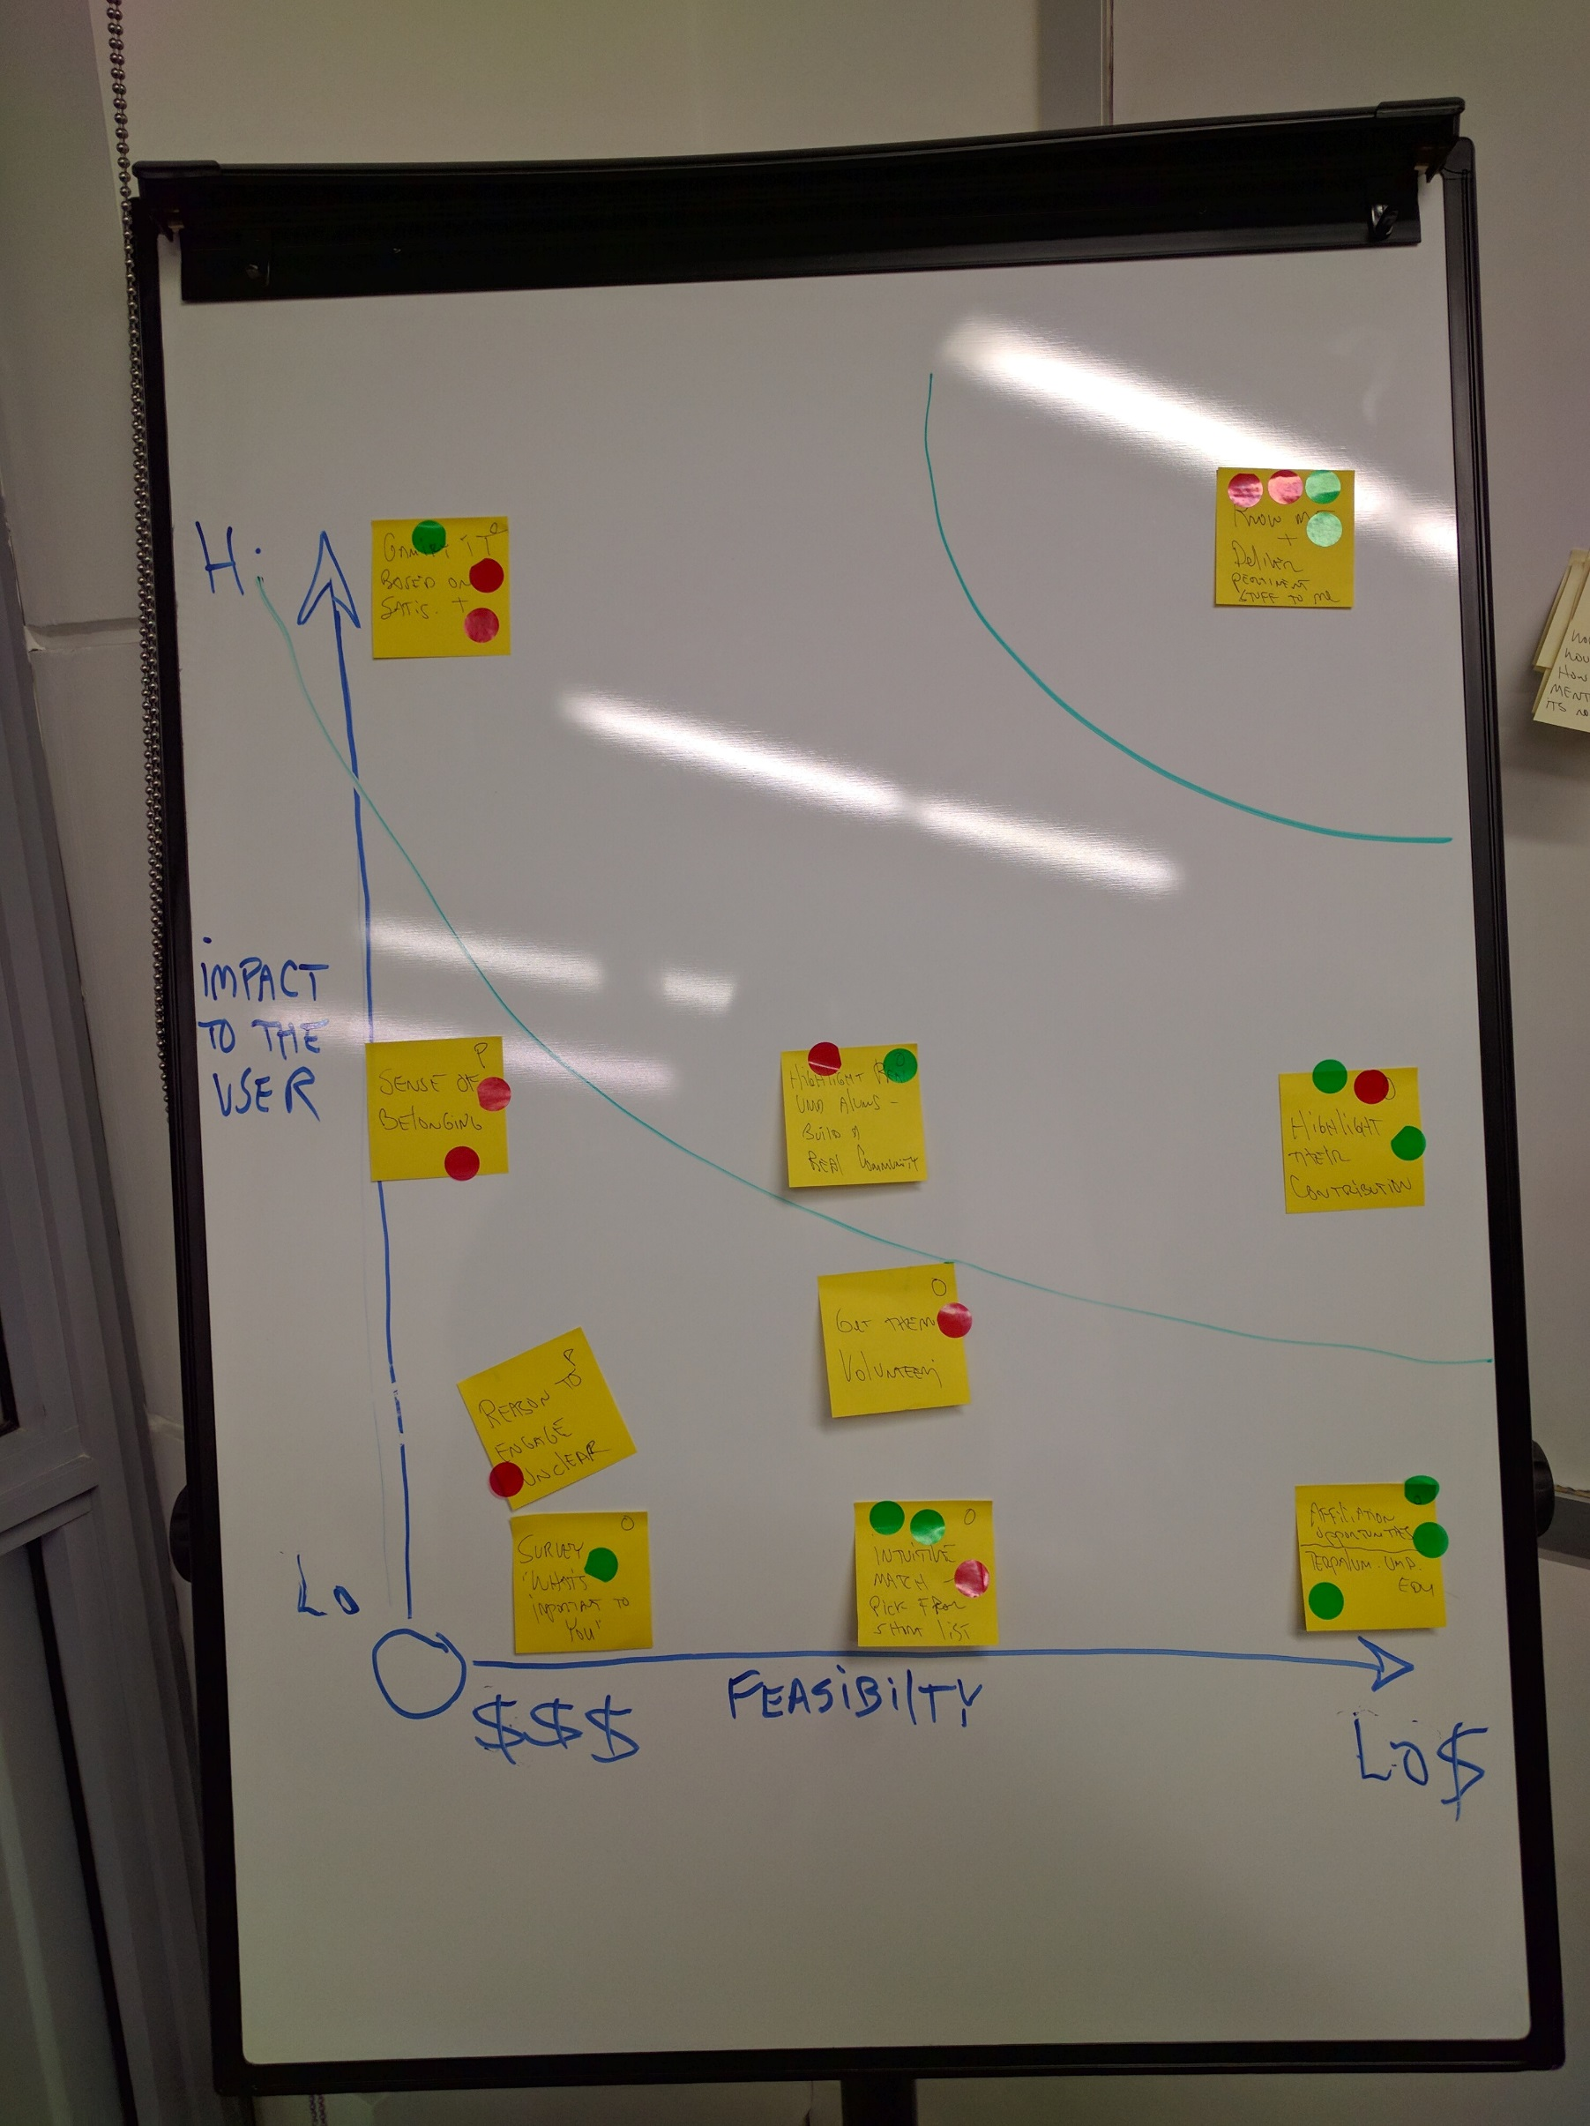
November
Prioritization
Mentors: Know me and deliver stuff pertinent to me, Create a Mentor Community, Gamify it based on satisfaction
Mentees: Automated Matching, Facilitate initial interactions, Humanizing of Mentors through success and setback stories
Diversity in thought makes for strong solutions
IBM Public Service | © 2016 IBM Corporation

Slide 11

OUR TAKEAWAYS
IBM Public Service | © 2016 IBM Corporation

Slide 12
The Problem
After graduation, students drift from their connection to UMD but remain connected to each other and their organizations
IBM Public Service | © 2016 IBM Corporation
Notes:
, because students feel connected to organizations, professors and friends not the University.

Slide 13
Another Problem
“I’d like to connect to other Alums, but I have no way to do it. I would mentor but I don’t want to waste time doing it”
IBM Public Service | © 2016 IBM Corporation
Notes:
We should mention that mentors need to get something out of it

Slide 14
A Connection Success
“In Art Education, mentoring is set up & made easy for me – I have 2. I don’t know what I’d do if it wasn’t brought to me…
IBM Public Service | © 2016 IBM Corporation
Notes:
Student sounds passive but was not. The point she was making is that she credits the major for getting her mentors. She was clearly grateful & engaged. She belongs.

Slide 15
The Solution
A compelling mentoring experience facilitated by UMD starting with Mechanical Engineering expanding to the whole University
IBM Public Service | © 2016 IBM Corporation
Notes:
that allows for connection between and within the mentor and mentee communities
Once engaged, then spider it out from there & create more robust engagement with all the Univ has to offer

Slide 16
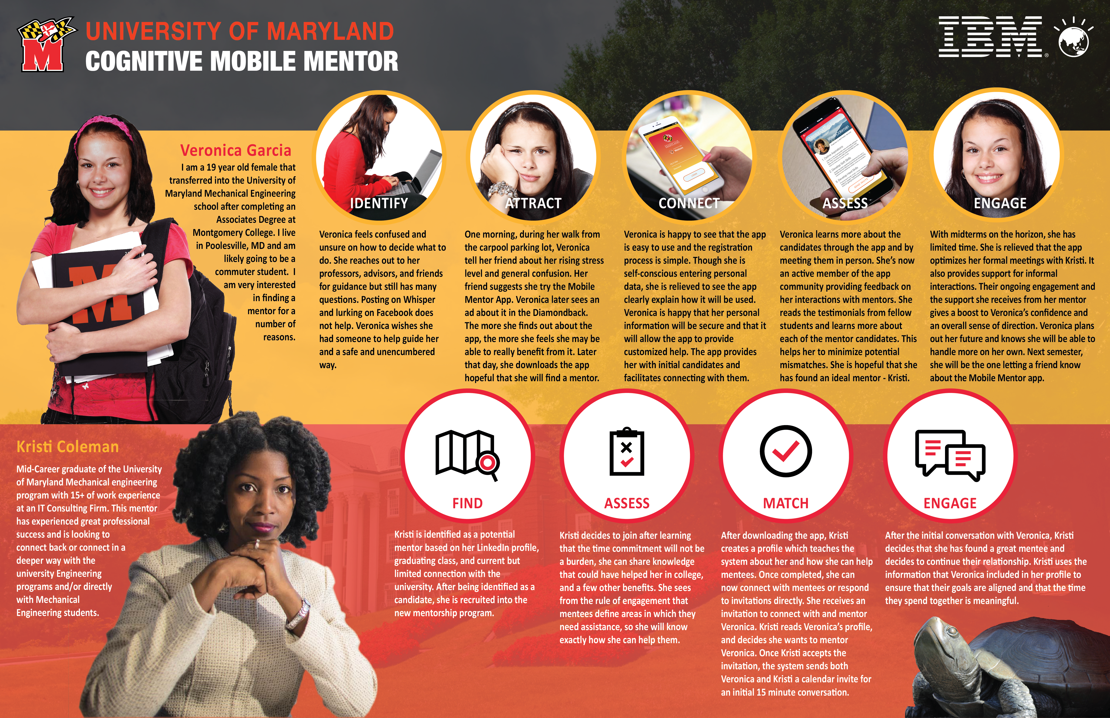

Slide 17
IBM Public Service | © 2016 IBM Corporation

Slide 18
Recap
Journey to Design Thinking
Design Thinking Artifacts
A Glimpse of the possible
IBM Public Service | © 2016 IBM Corporation

Slide 19
Next Steps
Does the concept resonate?
Proposal: Deliver a working pilot app
How long do you need to regroup based on this session?
IBM Public Service | © 2016 IBM Corporation

Slide 21

